Slide 1
Contactless and Indirect Sensing
Amitangshu Pal
Notes:
Hello everyone, I am Amitangshu Pal.
So this is a joint work with my supervisor Dr. Krishna Kant from Temple University.
Now in this work, we have developed a proof-of-elapsed time consensus mechanism with for BC networks, named DC-PoET. And interestingly, the DC-PoET is influenced by the distributed coordination protocol in wireless networks, which I am going to present in this talk.
So I work in the networking area, mainly in the wireless domain.
Now interestingly as I came from a wireless background, I have looked at the consensus problem in BC networks from the wireless angle, and finally come up with a consensus mechanism that is mainly influenced by the distributed coordination protocol in wireless networks,

Slide 2
Contactless Human Presence/Activity Sensing

Slide 3

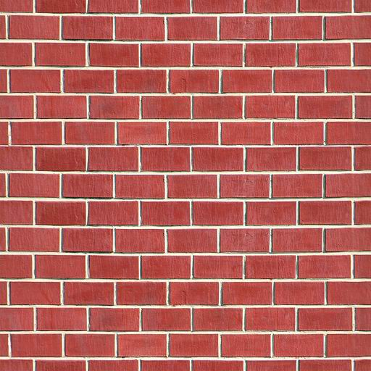
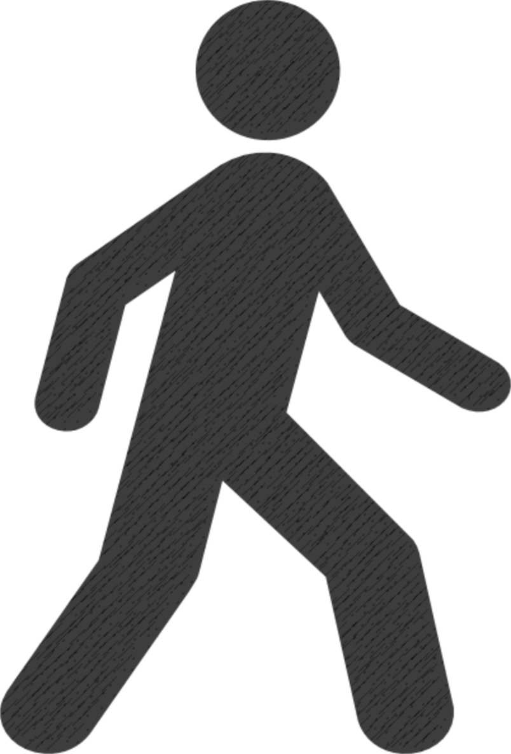
Measuring Distances
Tx
Rx
Distance = Reflection time x speed of light
http://people.csail.mit.edu/fadel/wivi/
Notes:
So, WiTrack works using body radio reflections. It has a transmit antenna and a receive antenna. It transmits a wireless signal, part of that signal is going to traverse the wall. [animate]
Then, a minute part of that signal will reflect off a person behind the wall, and an even smaller part is going to traverse the wall back. [animate]
Using this minute reflection that we receive, we would like to localize the person – that is, we would like to know where this person is with respect to the WiTrack device. To do that, we need to measure the distance of this person from WiTrack. And, we’re going to use a very simple equation that we all know, which is: [animate] distance is equal to the reflection time multiplied by the speed of light.
So, if we can measure the reflection time, then we can get the distance. [animate]
So, how do we measure the reflection time?

Slide 4
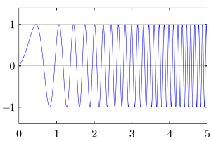
Frequency Modulated Carrier Wave (FMCW)
Transmitted
Received
ΔF
Frequency
=
ΔF
slope
Reflection Time
Time
t
t+ΔT
How do we measure ΔF?
Notes:
To address this issue, we borrow a technique from radar systems, called FMCW – frequency modulated carrier waves.
So let me tell you how FMCW works. Instead of transmitting a narrow pulse, we’re going to transmit a signal whose frequency linearly increases with time like the signal over here. As you can see, time and frequency are linearly related.
Now, as we said earlier, this signal will hit a reflector and come back, so we receive the reflection of this signal after the reflection time. Recall that this reflection time is very hard to measure. The nice thing about this FMCW signal is that the transmitted and received signal are also shifted with each other in frequency by some delta f. So, if we can measure delta f, and we know the slope that we pick for our FMCW, we can obtain the reflection time using the equation reflection time is equal to delta f divided by the slope. So the question becomes, how can we subtract the two signals to obtain delta f.

Slide 5
Measuring ΔF
Subtracting frequencies is easy
Can be done using a mixer (low-power; cheap)
Power
Transmitted
Mixer
FFT
Received
ΔF
ΔF ➔Reflection Time ➔ Distance
Notes:
You know what, subtracting signals in frequencies is very easy. In fact, this is exactly what you do when you take a WiFi signal and remove the carrier frequency. So you know that WiFi signals are transmitted at 2.4GHz, but when you operate on them, you only operate on the 20MHz channel, which means that you subtracted the 2.4GHz carrier.
That subtraction is typically done using a passive component called a mixer, which is cheap and does not consume power, and as a matter of fact, is present in all of our wireless transceivers.
So what we’re going to do is take the transmitted and received signals, feed them to the mixer – the mixer naturally subtracts the frequencies and produces a signal whose frequency is delta F. Now we’re going to pass this output through an FFT to take the fourier transform and obtain the spectrum. If we look at the power of this signal as a function of time, we will see that it spikes at delta F.
So, to summarize, because we can compute delta f easily, we can obtain from it the reflection time from delta f divided by the slope, and then multiply the reflection time by the speed of light to get the distance.

Slide 6
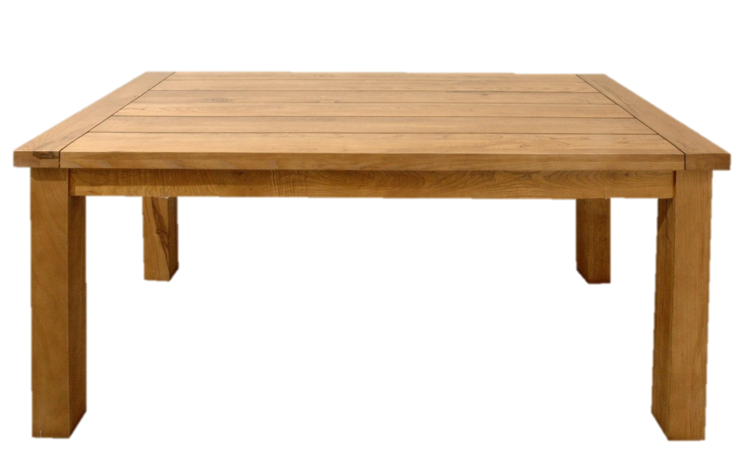
Challenge: Multipath➔ Many Reflections
Tx
Rx
Multi-paths mask person
Reflection Power
Distance
Notes:
Great, now we have a way to compute the distance to a reflector. So, are we done? Unfortunately not, because there is this problem that we all in wireless talk about: multipath. That is, when you transmit a signal, it will reflect off everything in the environment, not just the person. So, you get all of these reflections.
[animate]
So, when you transmit the signal, it will not only reflect off the person, it will also reflect off the wall, of the table, and so on.
Now, if we try to plot the reflection power as a function of distance, we obtain a plot like this one. The plot shows many different peaks due to the different reflectors at these distances – and they are caused by the multipath due to the different objects in the environment.[animate]
Now, how can we find the reflection of the person from all this clutter?

Slide 7
Challenge: Multipath➔ Many Reflections
Static objects don’t move
Multi-path
-
@ time t
Power
Why 2 peaks when we only have one moving person?
Multi-path
Distance
@ time t+30ms
Power
=
Distance
2 meters
Power
Distance
Notes:
The idea is quite simple. All of the static objects do not move, so we can eliminate their reflections by subtracting consecutive measurements. In contrast, a human tends to move, and hence if we subtract consecutive measurements, his reflection survives.
Let’s say we take a measurement at some time t, and plot the reflection power as a function of distance. Then, let us take another measurement after 30 milliseconds. And, as we can see, both of them have the same multipath profile. [animate]
Now, let us subtract these two measurements from each other. [animate]
We will obtain a profile like this one. Indeed, it removed all of the static reflections, and the big multipaths disappeared.
But we have a weird behavior: we see 2 main peaks – which means that there are two moving reflectors, despite the fact that we have a single person. And these reflectors are about 2 meters away from each. So why is that?

Slide 8
Dynamic Multipath
The direct reflection arrives before dynamic multipath!
Tx
Rx
Moving Person
Dynamic Multi-path
Power
Distance
Notes:
This is due to dynamic multipath. Let me show you what that means.
After we do background subtraction, we still get the reflection coming back from the person. This reflection comes directly back to our receive antenna. [animate]
But, if we also have a table, then the person’s reflection may also bounce off the table before it arrives at the receive antenna. [animate]
And so this is why we get multiple peaks [animate].
But, how can know which of these peaks is due to the person and which of them is due to dynamic multipath? [pause]
Well, the direct reflection from the person will arrive earlier than the dynamic multipath, since it will travel a shorter distance. [animate]
So we can simply chose the first peak as the one that corresponds to the person, while the others are dynamic multipath.
Now, you might be wondering why don’t we take the highest peak. Well, because in some scenarios the direct reflection may have less power than the dynamic multipath, and that happens when the person is behind a piece of furniture like a couch.

Slide 9

From Distances to Localization
d
Rx
Tx
Person can be anywhere on a circle whose center are (Tx,Rx)
One circle is not enough to localize!
Notes:
So far, we have discovered how we can measure the round-trip distance from the transmit antenna to the person and back to the receive antenna. Unfortunately, this is not enough for us to localize.
Specifically, this distance can correspond to this location, [animate] this location, [animate] or this location. In fact, geometrically, the person could be anywhere on an ellipse whose foci are Tx and Rx. But one ellipse is not enough to localize.

Slide 10
From Distances to Localization
d
d’
Rx
Tx
Rx’
Extend to 3D by using 3 Rx antennas and taking the intersection of spheres
Notes:
To localize a person in WiTrack, we add a second receive antenna and compute the distance d’. Now we will have another ellipse, and we know that the person is at one of the two intersections of these 2 ellipses.
Because WiTrack uses directional antennas, we know that the person is at the intersection point in front of the antennas. So, using one transmit antenna and two receive antennas, we can localize a person into a plane.
It is straightforward to extend this to 3D motion tracking. We just add a third antenna, and now instead of ellipses, we have ellipsoids. So, we take the intersection of these ellipsoids to localize in 3D.

Slide 11
Through-Wall Localization Accuracy
13cm
1
0.8
0.6
0.4
0.2
0
10cm
21cm
CDF
0 20 40 60 80 100
Centimeter-scale localization without requiring the user to carry a wireless device
Location Error (in centimeters)
Notes:
We run 100 experiments, and collect about half a million location estimates in total.
On the x axis, we plot the location error, and on the y-axis, we plot the CDF over the experiments. Here are the results, as you can see, the median localization error is 10cm on the x-axis, 13cm on the y, and 21 on the z.
The thing to notice is that WiTrack achieves cm-scale accuracy purely using radio reflections, and without requiring the user to carry a wireless device.

Slide 12
What’s About Multiple Moving Users?
Tx
Rx
Two types of multi-path:
1. Direct furniture reflection:
2. Indirect reflections:
eliminated by subtracting consecutive measurements
eliminated by choosing shortest round-trip distance
Needs User to Move
Fails for multiple users
Notes:
Now, dealing with the multi-path effect when you have a single moving user is relatively easy. But, when the user is static or when you have multiple users, dealing with multipath becomes extremely problematic. Let me show this to you visually.
For example, when you have a single user, he will reflect the signal back. Now, if we have a table in the environment, we will see two types of multipath. The first is direct reflection from the table itself. The second type of multipath is when the signal reflects on the user then on the table or on the table then on the user.
Eliminating both types of multipath when you have a single moving user is easy.
You can eliminate direct reflections using the fact that the table is static while the user is moving. So, by subtracting consecutive measurements, the table’s reflection will disappear but the user’s reflections would survive.
However, if the user is static, then you will also remove his reflection. So this technique requires the user to move to localize him.
Dealing with the second type of m-path, the indirect one, is also easy when you have a single person. Because all you have to do is to notice that any indirect m-path is going to take a longer path than the direct reflection coming off the user directly to the device. So, all you have to do, if there is only 1 user, is to pick the location of the first reflection, which will be the location of the user’s body.
On the other hand, when you have multiple users, You can’t anymore pick the closest reflection because maybe the second user is at a distance further than the indirect reflection of the first user. So, you cannot use the same mechanism anymore to eliminate indirect reflections.

Slide 13
Dealing with multi-path is easy when there is one moving user
Need new mechanisms to eliminate muti-path
Tx
Rx
Two types of multi-path:
1. Direct furniture reflection:
2. Indirect reflections:
eliminated by subtracting consecutive measurements
eliminated by choosing shortest round-trip distance
Needs User to Move
Fails for multiple users
Notes:
And this means that we will need new mechanisms for eliminating multi-path. Let me first tell you how we can deal with indirect reflections and localize multiple users, and later in the talk, I will go back to telling you how we can localize static users.

Slide 14
Combining across multiple vantage points
Experiment: Two users walking
Setup
Single Vantage Point
Notes:
We run an experiment, where we have two people walking in the environment, [animate] similar to the setup I have on the left. The experiment is run in a fully-furnished room with tables, chairs, and computers.
Now, let me show you the output that we get from a single vantage point. Here we see a heatmap indicating the probability distribution of where we think the people is. The red shows highest probability, while the blue shows the lowest probability. And these ellipses correspond to the round-trip distances that I described to you earlier. Here, we see multiple ellipses even though there are only 2 users in the environment because of indirect reflections.

Slide 15
Combining across multiple vantage points
Experiment: Two users walking
Setup
Two Vantage Points
Notes:
And this is the output when we combine two vantage points.

Slide 16
Combining across multiple vantage points
Experiment: Two users walking
Setup
16 Vantage Points
Localize the two users
Notes:
And this is the output after we add 16 different vantage points. Now, it’s very clear where the two users are. In fact, the more accurate you want your localization, the larger the number of vantage points you need.
So, all of this is great. We are now able to localize two users. So are we done?

Slide 17
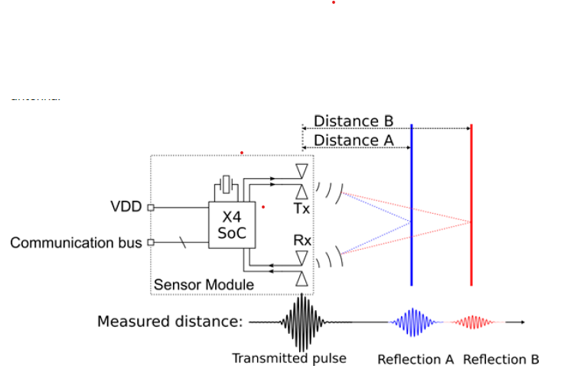
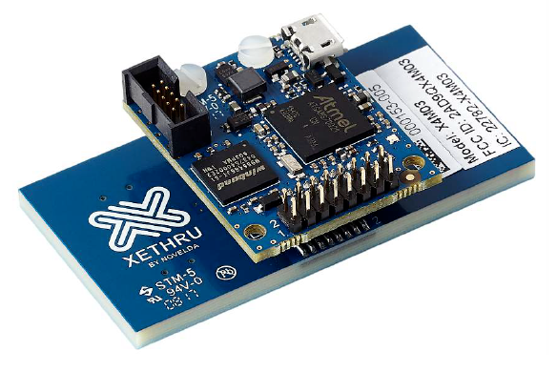
Novelda XeThru X4M03 UWB radar
6-8.5 GHz
9.9 meters
±60⁰ angular resolution

Slide 18
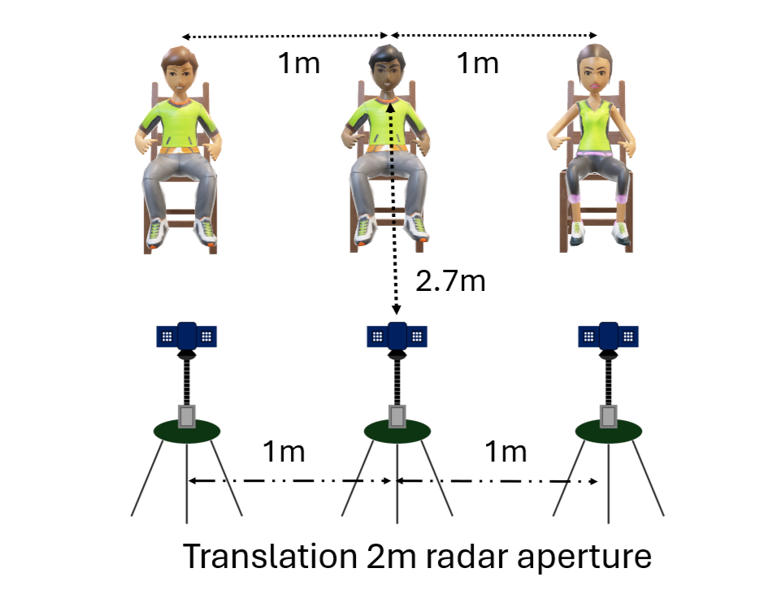
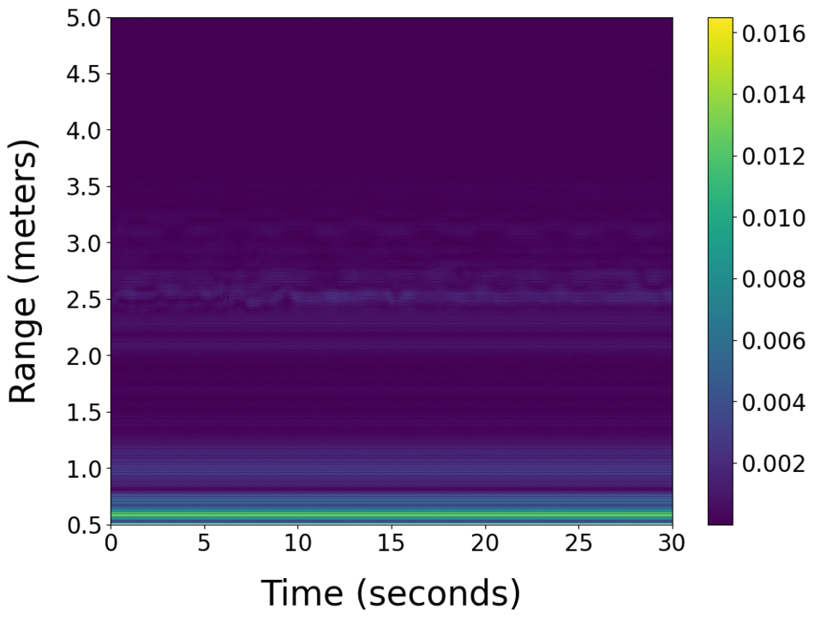
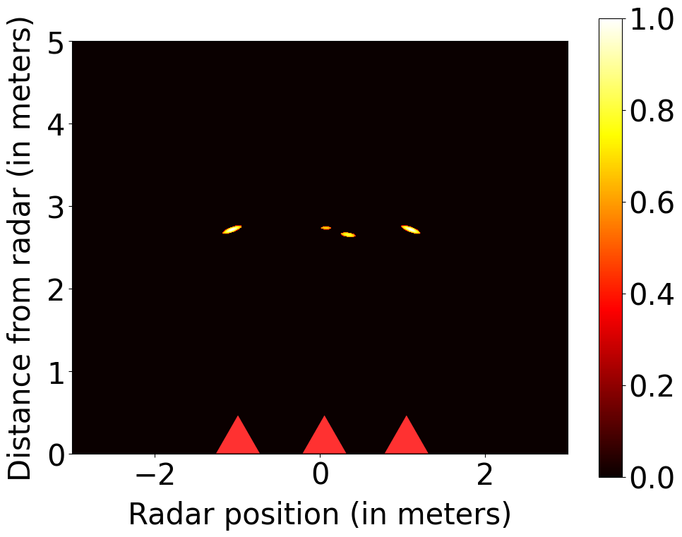
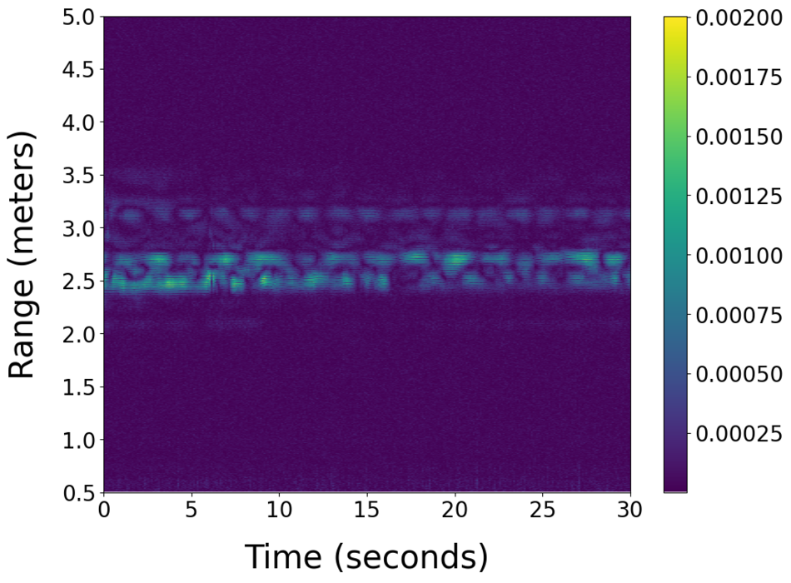

Slide 19
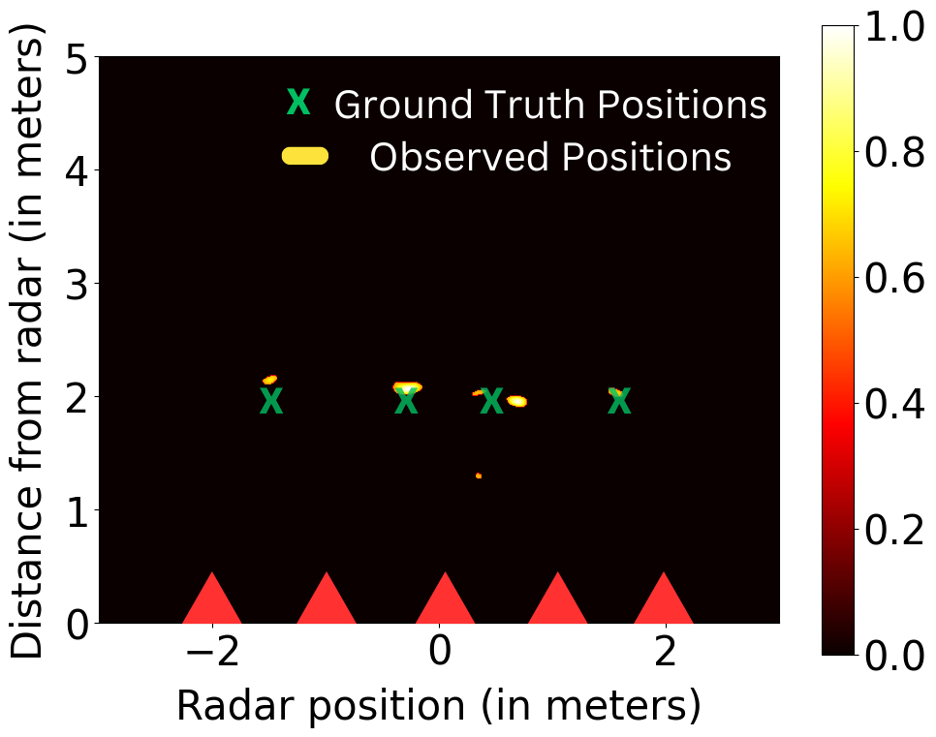
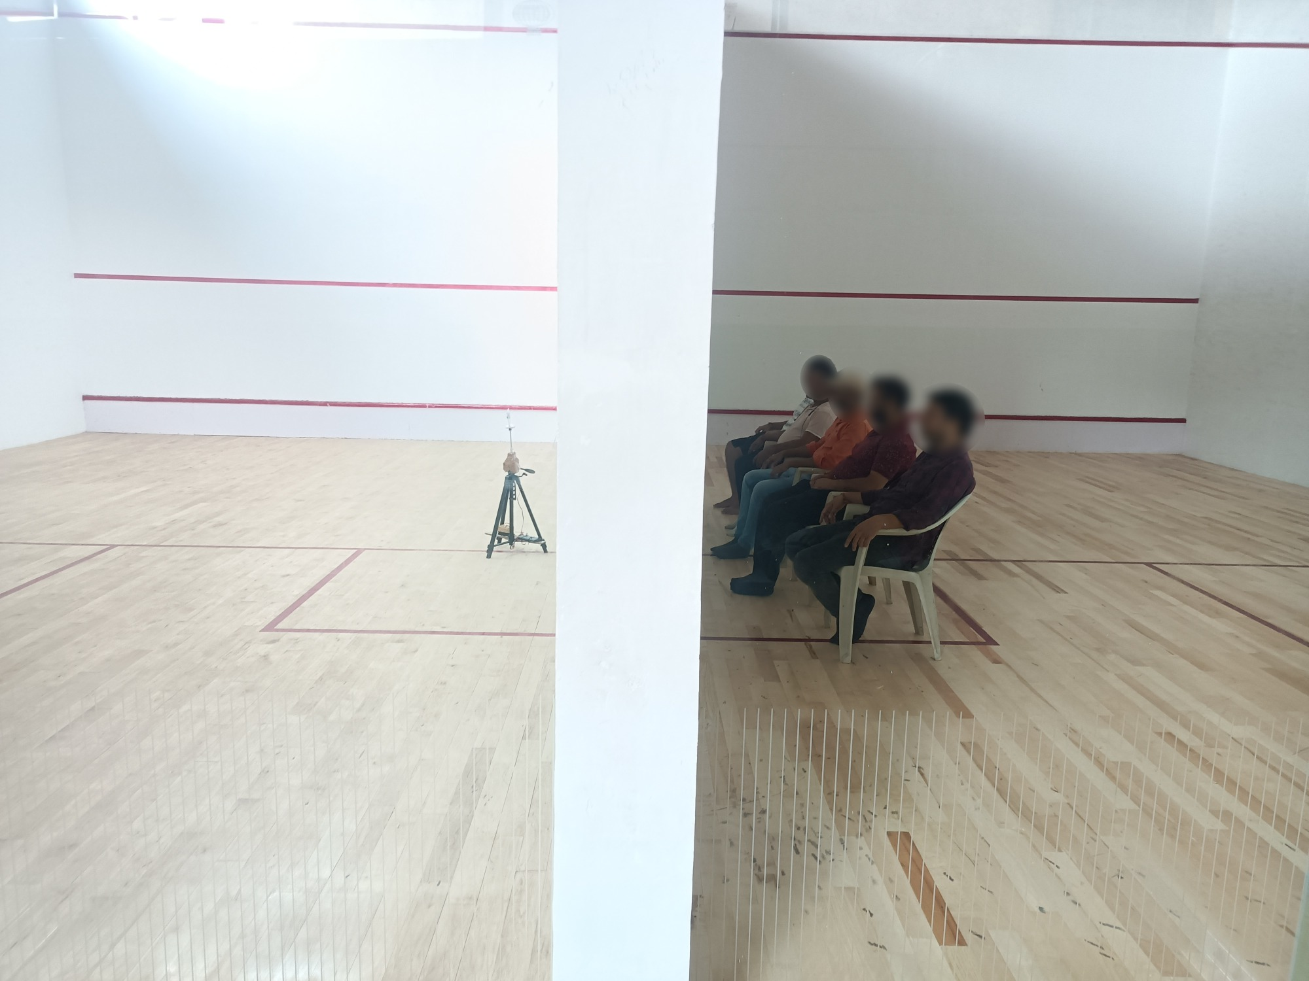
Through the wall sensing

Slide 20
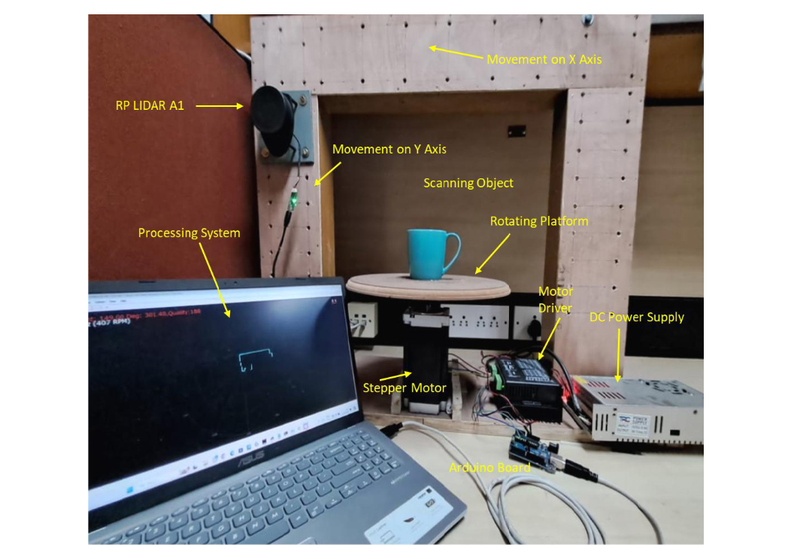

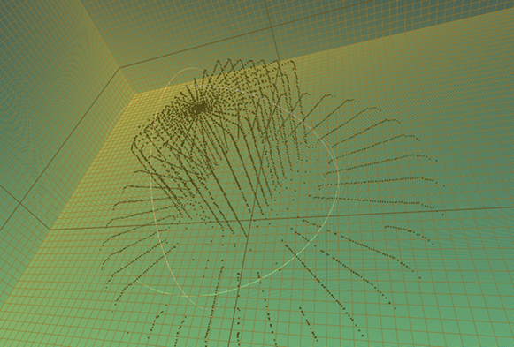
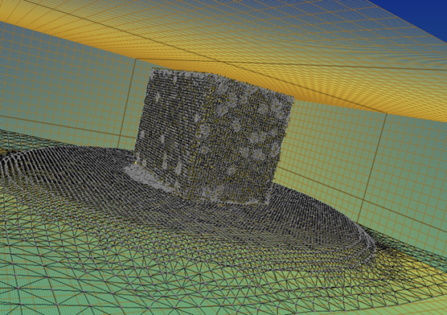
LIDAR based sensing

Slide 21
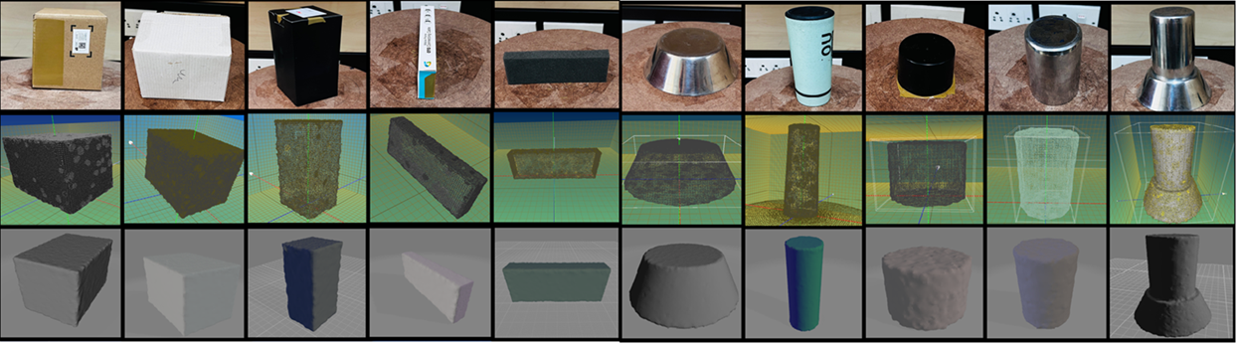
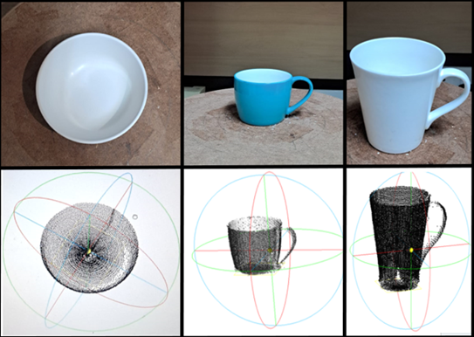
LIDAR based sensing

Slide 22
Contactless Liquid Sensing

Slide 23


Differentiating the Type of Liquid
Pepsi
Coca-Cola
https://www.youtube.com/watch?v=XNsXXGJIGT8
Notes:
We want to obtain such precision that we will be able to even distinguish between Pepsi and Coke using the same approach.

Slide 24


Refractive Index = $\frac{sinα}{sinβ}$ = $\frac{c}{v}$
Differentiating the Type of Liquid
Velocity c
Velocity v
Velocity c
β
α
Notes:
But there is another interpretation of refractive index which is about the velocity of the signals. If you shine a signal perpendicular to the liquid surface, the signal will not bend but the signal will still slow down. Refractive index is also defined as the ratio of the velocities inside and outside the liquid. That is the opportunity we have. In other words, if we can somehow measure the slowdown of the signal after passing through the liquid, then we know what the refractive index is.

Slide 25
Time of Flight
Liquid
ToF with liquid
ToF in air
Tx
Rx
d
Notes:
Now, suppose we insert a liquid column of a known width between the two devices, and again measure the ToF. This ToF will be larger, right? Why? Because the liquid will slow down the signal.

Slide 26
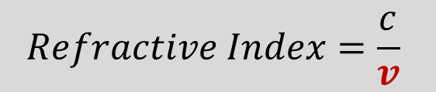

ToF gives Refractive Index
$$TOF_{liq} −TOF_{air}=\frac{d}{v} −\frac{d}{c}$$
$$Refractive Index=\frac{c}{v}$$
Notes:
Now if we do the math, if I measure the ToF with the liquid
{click}
and then again without the liquid
{click},
the difference in the ToFs is simply…d by v minus d by c, where v is the velocity inside the liquid and d is the width of the liquid.
{click}
The velocity inside the liquid is the only unknown. Thus, by measuring the time of flight very accurately, we can derive the velocity and thereby calculate the refractive index. That is our high level idea in this work.

Slide 27
Channel Impulse Response
Wire
Tx
Rx
CIR Taps
Notes:
By connecting the wire, we have now introduced a new peak in the channel impulse response.

Slide 28
Channel Impulse Response
T_{air}
T_{wire}
Wire
Tx
Rx
CIR Taps
Notes:
The first peak, corresponds to the shorted wired path and the second peak corresponds to the signal received through the air path.

Slide 29
CIR with Liquid
T_{air}
Liquid
T_{wire}
T_{liq}
Wire
Tx
Rx
CIR Taps
Notes:
Now, if we introduce a liquid column between the two antennas and send another wireless signal, the signal will slow down. This slow-down is observable in the channel impulse response. T_liquid is to the right of T_air.

Slide 30
Double Differencing – Relative ToF
T_{air}
e
d
u
T_{wire}
liq
t
ΔT
i
l
air
p
m
T_{liq}
A
0
5
10
15
20
0
500
1000
1500
2000
Time (nanoseconds)
$$ΔT_{air}^{liq}=\left(T_{liq}−T_{wire}\right)−\left(T_{air}−T_{wire}\right)=\frac{d}{v} −\frac{d}{c}$$
CIR Tap
Notes:
Now what we really want, is the difference between the blue and the green peak. But these lines correspond to two different wireless packets, so this is not directly measurable. So how do we measure that? The difference between green and blue peak is essentially the difference between blue and red minus the difference between green and red. Both of these are individually measurable quantities.

Slide 31
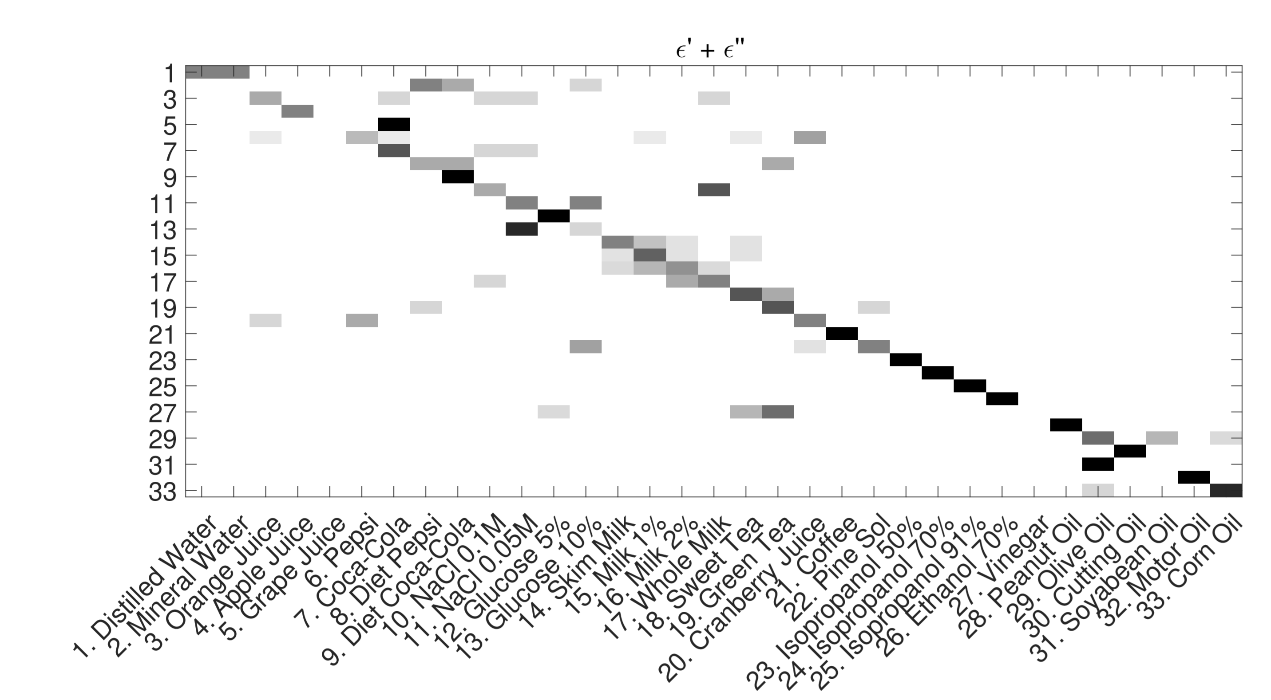

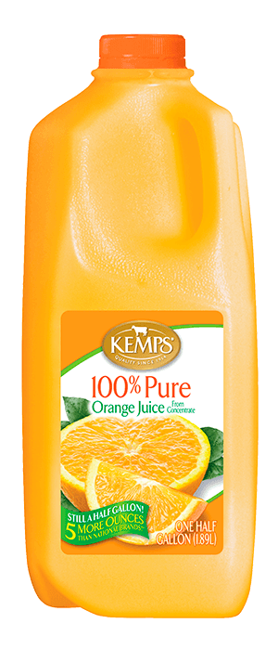














Results – Identification
Notes:
Now what we really want, is the difference between the blue and the green peak. But these lines correspond to two different wireless packets, so this is not directly measurable. So how do we measure that? The difference between green and blue peak is essentially the difference between blue and red minus the difference between green and red. Both of these are individually measurable quantities.

Slide 32
Indirect Soil Moisture Sensing

Slide 33
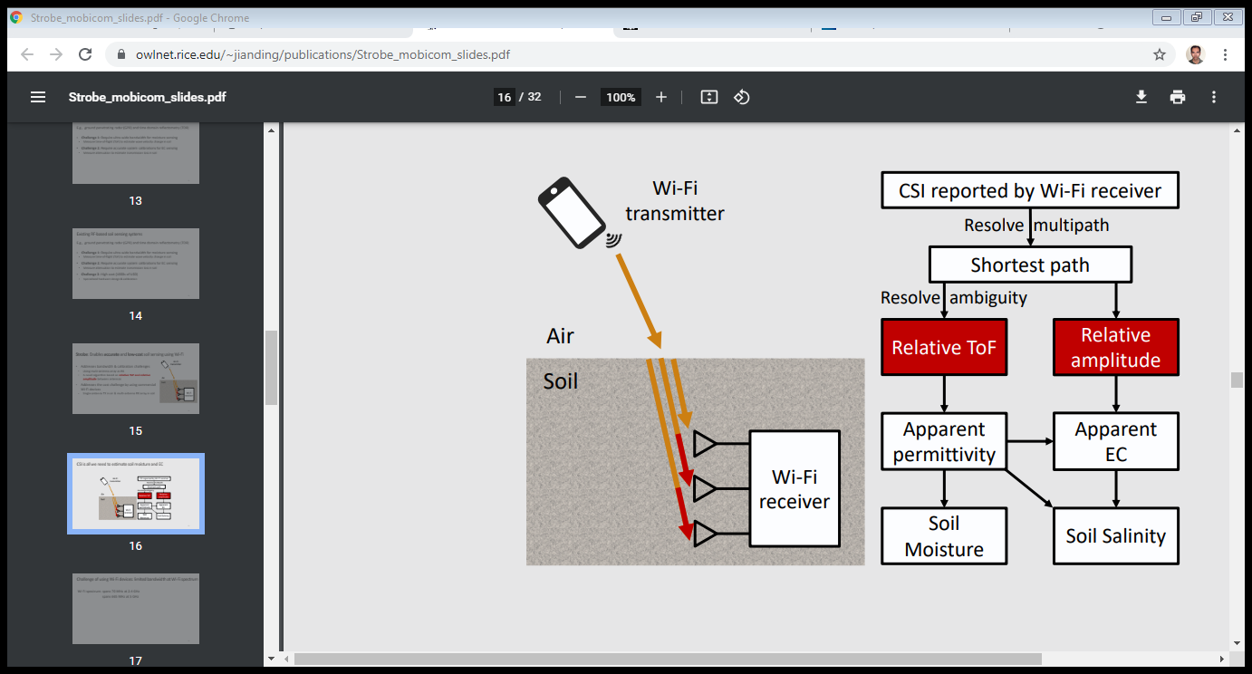
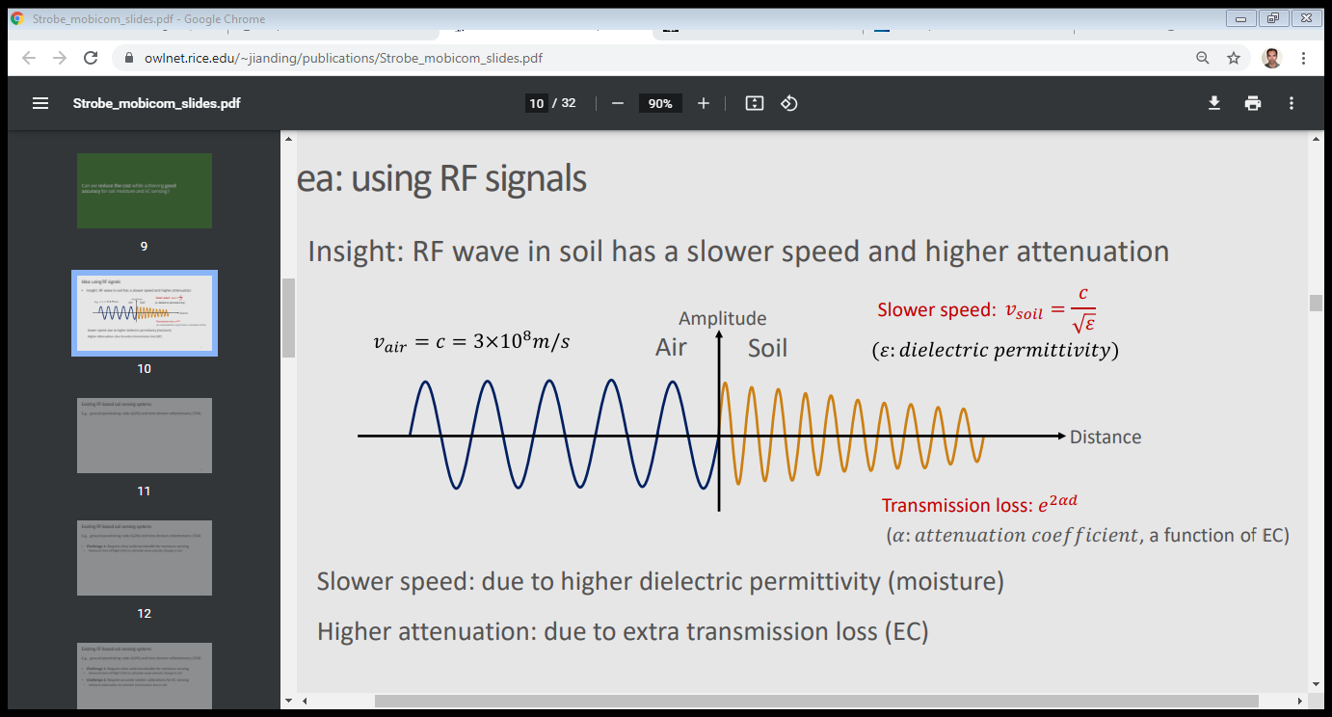
Soil Moisture Sensing Using Wireless
RF wave in soil has a slower speed and higher attenuation
Slower speed: due to higher dielectric permittivity → moisture
Higher attenuation: due to extra transmission loss → electrical conductivity
https://www.owlnet.rice.edu/~jianding/publications/Strobe_mobicom_slides.pdf
Notes:
So, what we do in our system is that we use multi-resolution subtraction windows to eliminate multi-path while being able to localize both static and moving users. And we operate at these different subtraction windows together.
Now that I have described to you the basic components of our system, let me show you a video of how it works in practice.

Slide 34
Soil Moisture Sensing Using Wireless
Easier to measure the relative ToF and relative amplitude between antennas
Notes:
So, what we do in our system is that we use multi-resolution subtraction windows to eliminate multi-path while being able to localize both static and moving users. And we operate at these different subtraction windows together.
Now that I have described to you the basic components of our system, let me show you a video of how it works in practice.

Slide 35
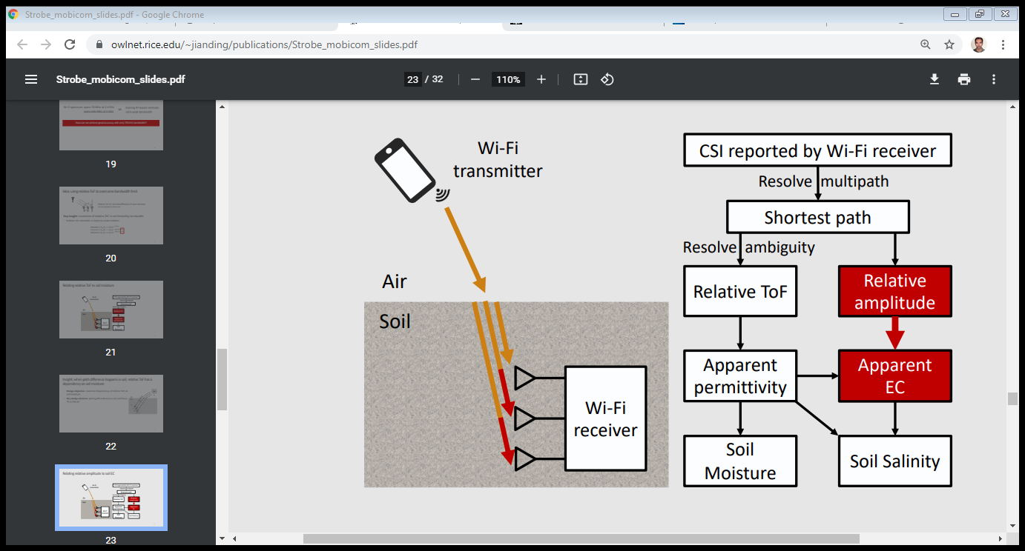
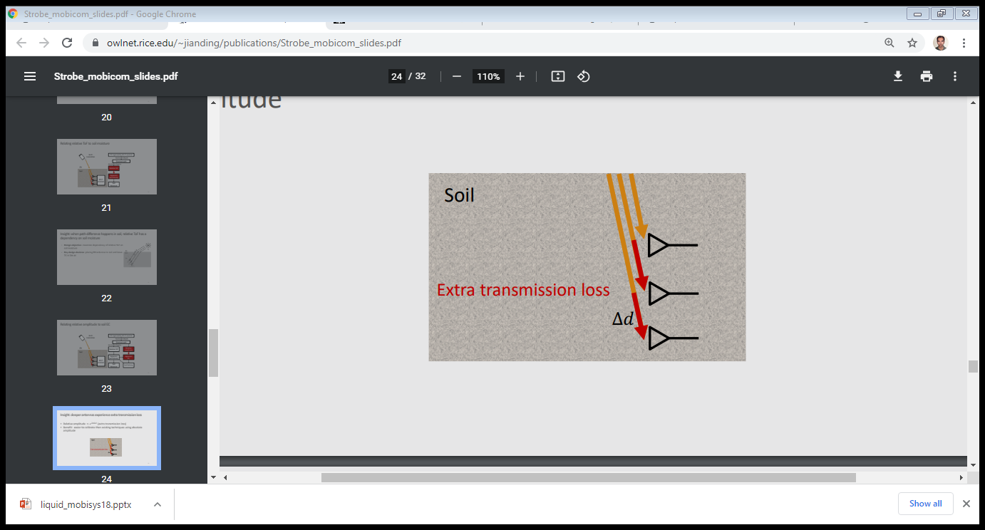
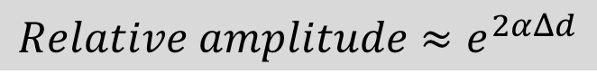
Relative Amplitude Estimation
$Relative amplitude≈e^{2αΔd}$
Notes:
So, what we do in our system is that we use multi-resolution subtraction windows to eliminate multi-path while being able to localize both static and moving users. And we operate at these different subtraction windows together.
Now that I have described to you the basic components of our system, let me show you a video of how it works in practice.

